Slide 1

Telstra Telco customer usage analysis
Michael Le

Slide 2

Requirements
Install and Download SQL Server Express (2022,or 2025 (much preferred)) from Microsoft
Files and sources from my repository:
Main-Stuff/DA Bootcamp 2026 Emergi Mentors/Week 2 SQL Mastery/Module 2 SQL for Business Analytics Beginner Projects/Telstra_Telecom_Churn_Analysis at main · Mikele02171/Main-Stuff

Slide 3

Data Structure and Business Questions
Creating Telstra Tables
1. Telstra Customers Table
2. Usage Records Table
Show Customer names WITH their Dec Usage
Which customers had NO usage in December?
Average usage by plan tier (Bronze/Silver/Gold)
Joining Customers, Usage and Transaction Tables
Usage summary by plan tier

Slide 4

Telstra Customer Table (Demo)
IF OBJECT_ID('telstra_customers', 'U') IS NOT NULL DROP TABLE telstra_customers; --Comment out if this tables exists.
CREATE TABLE telstra_customers (
customer_id INT PRIMARY KEY,
customer_name VARCHAR(100),
plan_tier VARCHAR(20), -- Bronze, Silver, Gold
monthly_fee DECIMAL(10,2),
state VARCHAR(3),
signup_date DATE
);
-- Insert sample data
INSERT INTO telstra_customers VALUES
(101, 'Sarah Williams', 'Gold', 99.00, 'NSW', '2023-01-15'),
(102, 'Michael Zhang', 'Silver', 69.00, 'VIC', '2023-02-20'),
(103, 'Emma Thompson', 'Gold', 99.00, 'QLD', '2023-03-10'),
(104, 'James O''Brien', 'Bronze', 49.00, 'NSW', '2023-04-05'),
(105, 'Olivia Chen', 'Gold', 99.00, 'VIC', '2023-05-18'),
(106, 'Noah Anderson', 'Silver', 69.00, 'NSW', '2023-06-22'),
(107, 'Sophia Kumar', 'Bronze', 49.00, 'QLD', '2023-07-11'),
(108, 'William Taylor', 'Gold', 99.00, 'VIC', '2024-11-25'), -- New customer, no usage yet!
(109, 'Ava Martin', 'Silver', 69.00, 'NSW', '2024-12-01'), -- New customer, no usage yet!
(110, 'Lucas Brown', 'Bronze', 49.00, 'QLD', '2024-12-15'); -- New customer, no usage yet!

Slide 5

Usage Records Table (Demo)
IF OBJECT_ID('telstra_usage', 'U') IS NOT NULL DROP TABLE telstra_usage;
CREATE TABLE telstra_usage (
usage_id INT PRIMARY KEY,
customer_id INT,
usage_month DATE,
data_used_gb DECIMAL(10,2),
calls_minutes INT,
sms_count INT
);
-- November 2024 usage
(1, 101, '2024-11-01', 45.5, 320, 150),
(2, 102, '2024-11-01', 22.3, 180, 80),
(3, 103, '2024-11-01', 67.8, 420, 200),
(4, 104, '2024-11-01', 5.2, 90, 30),
(5, 105, '2024-11-01', 88.9, 510, 250),
(6, 106, '2024-11-01', 31.4, 220, 110),
(7, 107, '2024-11-01', 8.7, 60, 25),
-- December 2024 usage
(8, 101, '2024-12-01', 52.3, 340, 160),
(9, 102, '2024-12-01', 28.9, 200, 95),
(10, 103, '2024-12-01', 71.2, 450, 220),
(11, 104, '2024-12-01', 6.8, 100, 35),
(12, 105, '2024-12-01', 92.5, 530, 270),
(13, 106, '2024-12-01', 35.7, 240, 120),
(14, 107, '2024-12-01', 9.3, 70, 28);
-- NOTE: Customers 108, 109, 110 have NO usage records!

Slide 6
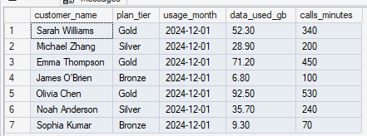
Match customer names with their Dec usage
SELECT
c.customer_name,
c.plan_tier,
u.usage_month,
u.data_used_gb,
u.calls_minutes
FROM telstra_customers c
INNER JOIN telstra_usage u ON c.customer_id = u.customer_id
WHERE u.usage_month = '2024-12-01';

Slide 7
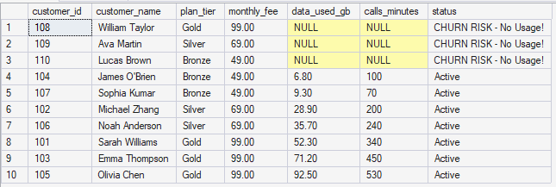
Which customers had NO usage in December?
SELECT
c.customer_id,
c.customer_name,
c.plan_tier,
c.monthly_fee,
u.data_used_gb,
u.calls_minutes,
CASE
WHEN u.usage_id IS NULL THEN 'CHURN RISK - No Usage!'
ELSE 'Active'
END AS status
FROM telstra_customers c
LEFT JOIN telstra_usage u ON c.customer_id = u.customer_id
AND u.usage_month = '2024-12-01'
ORDER BY u.data_used_gb ASC;

Slide 8
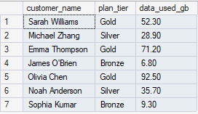
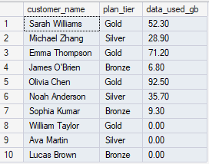
Average usage by plan tier (Bronze/Silver/Gold)
PRINT '--- INNER JOIN (only matching records) ---';
SELECT
c.customer_name,
c.plan_tier,
u.data_used_gb
FROM telstra_customers c
INNER JOIN telstra_usage u ON c.customer_id = u.customer_id
WHERE u.usage_month = '2024-12-01’;
PRINT '--- LEFT JOIN (all customers, even without usage) ---';
SELECT
c.customer_name,
c.plan_tier,
ISNULL(u.data_used_gb, 0) AS data_used_gb -- Replace NULL with 0
FROM telstra_customers c
LEFT JOIN telstra_usage u ON c.customer_id = u.customer_id
AND u.usage_month = '2024-12-01';

Slide 9

Usage summary by plan tier
SELECT
c.plan_tier,
COUNT(DISTINCT c.customer_id) AS total_customers,
COUNT(u.usage_id) AS usage_records,
AVG(u.data_used_gb) AS avg_data_gb,
AVG(u.calls_minutes) AS avg_calls_minutes,
AVG(c.monthly_fee) AS avg_monthly_fee
FROM telstra_customers c
LEFT JOIN telstra_usage u ON c.customer_id = u.customer_id
WHERE u.usage_month >= '2024-11-01' OR u.usage_month IS NULL -- Nov-Dec + new customers
GROUP BY c.plan_tier
ORDER BY avg_monthly_fee DESC;

Slide 10
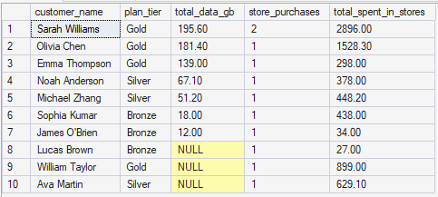
Joining Customers, Usage and Transaction Tables
SELECT
c.customer_name,
c.plan_tier,
SUM(u.data_used_gb) AS total_data_gb,
COUNT(DISTINCT t.transaction_id) AS store_purchases,
SUM(t.amount) AS total_spent_in_stores
FROM telstra_customers c
LEFT JOIN telstra_usage u ON c.customer_id = u.customer_id
LEFT JOIN customers cust ON c.customer_name = cust.customer_name -- Name matching (not ideal but demonstrates concept)
LEFT JOIN transactions t ON cust.customer_id = t.customer_id
GROUP BY c.customer_name, c.plan_tier
ORDER BY total_data_gb DESC;

